Slide 1
Chapter 36: Globalization and Resistance

Slide 2
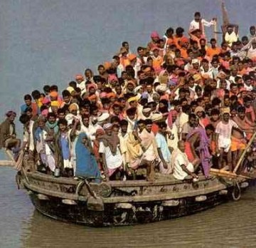
Globalization
Globalization: interconnectedness of all parts of the world (culture, communication, commerce, politics)
Increased toward the end of the 20th century, partly due to the entry into world markets of China and members of the former Soviet Union.
Massive population growth
Migration:
Guest Workers: large numbers of 3rd World immigrants have led to tensions in Western countries; low wages
Xenophobia
Modern travel has made it easier to migrate to (emigrate) and from (immigrate) countries.
Internationalism replaced nationalism as a dominant cultural theme.
Spread of English as global language

Slide 3
New Technology, Corporations, and Organizations
Technology has improved → easier to maintain contact over distances (esp. cell phones, computers, email, Internet
Multinational corporations: extend business across borders
Facilitate rapid increases in exports and imports
Seek cheap labor and undemanding environmental policies. In some cases, these are more powerful than the countries in which they operate.
Outsourcing: tactic of hiring outside workers (greatest in India)
Non-western countries seek global financial aid to develop
International Monetary Fund (IMF) and World Bank were founded after WWII to promote trade and offer loans
Meetings often marked by demonstrations, violence, and protest
Critics argue globalization has caused/exacerbated: environmental dangers, exploitation of laborers, disparity between rich and poor people/nations.

Slide 4
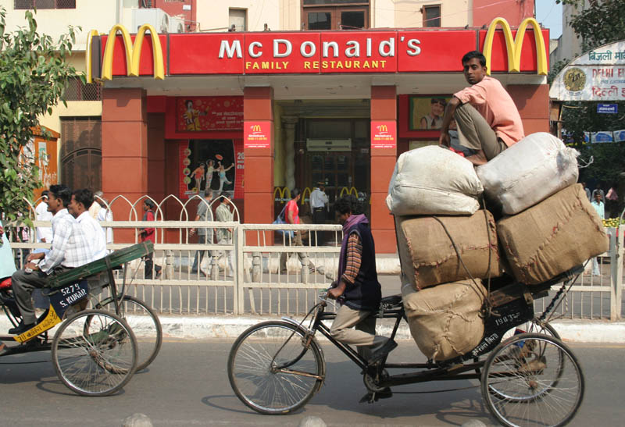
Cultural Globalization
Greater collaboration exists with English as the common language.
American fast-food chains; increase in obesity of children
American TV shows , music, and movies have world-wide audiences.
Other cultures often either celebrate American holidays, or have adopted American greeting-cards and presents.
Western styles of dress are pervasive across the globe.

Slide 5
New Religious Currents
Nationalism and religious revivalism are resistant to globalization.
Russian Orthodoxy has gained new prominence post-Communist Russia
Emphasize native distinctiveness
Fundamentalism: return to traditional beliefs and religious practices
Protestant, Muslim, Hindu, Catholic, etc.
Generally increases intolerance and exclusivity
Terrorism: often motivated by religion
Five Features of Fundamentalism
1) Dualism
(World is divided into clear cut binary categories: good/evil; right/wrong; them/us)
2) Paranoia
(Deep feeling of suspicion or rage directed towards those on the “other” side of the binary category)
3) Apocalyptic Orientation
(Obsession with the ending point of society; usually positively disposed to bring about that end)
4) Charismatic Leaders
(Commitment and dedication to that leader)
5) Total Conversion
(Once the fundamentalist embraces the ideology, they do so completely)

Slide 6
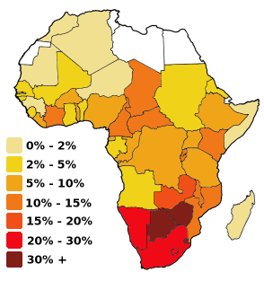
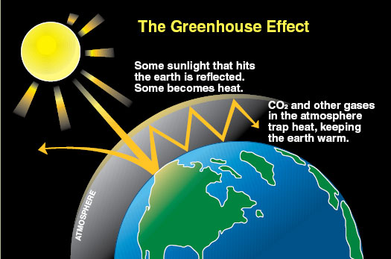
The Global Environment
Industrialization increased the scale of environmental hazards (China, Soviet Union)
Wealthiest countries consume products out of proportion to their population and contribute more pollution than developing nations.
Global diseases such as AIDS (worst in Sub-Saharan Africa)
Greenhouse Effect: increase of gases that cause overheating of the earth (not new, but now produced in much greater quantities)
Acknowledged by most scientists
Sources of gases: fossil fuel combustion, rice paddies, refrigeration
Impacts: rising sea levels, changes to natural patterns

