Slide 1
The world Between the Wars: Revolutions, depression, and authoritarian response
Chapter 29

Slide 2
Interwar Period- Big Picture
The 1920s were profoundly shaped by World War I and by movements well underway before the war.
Three major patterns emerged:
Western Europe recovered from the war only incompletely
The United States and Japan rose as giants in industrial production
Revolutions of lasting consequence shook Mexico, Russia, and China.
Each of these developments brought into doubt western Europe’s assumptions about its place as the dominant global power.

Slide 3
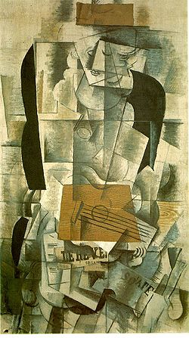
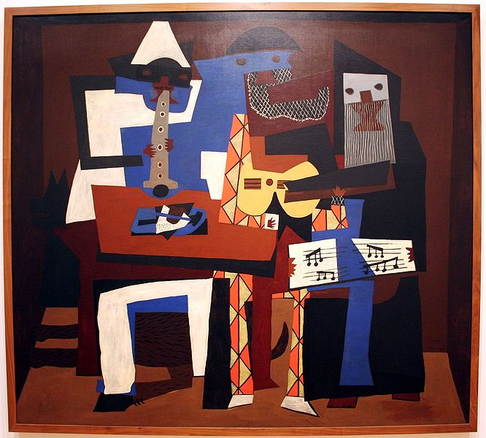
The Roaring Twenties
Bouncing Back After War?
A brief period of stability, even optimism, emerged in the middle of the 1920s.
Germany’s new democratic government promised friendship with its former enemies.
The Kellogg-Briand Pact, outlawing war, was signed by a number of nations.
Latter part of the decade, general economic prosperity and the introduction of consumer items (consumerism) like the radio and affordable automobiles raised hopes.
A burst of cultural creativity appeared in art, films, and literature
Cubism – Picasso
Women, who lost their economic gains in the war’s factories, but attained voting rights and social freedoms in several countries.
In science, important advances continued in physics, biology, and astronomy.
Enormous challenges
The United States and Japan registered economic gains and political tension.
New authoritarian movements surfaced in eastern Europe and Italy

Slide 4
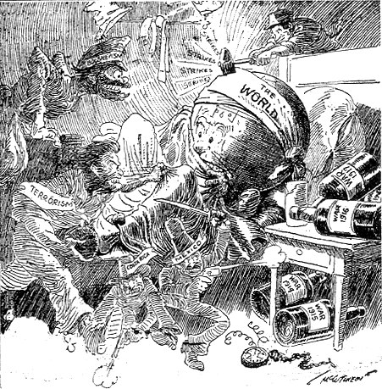
Other Industrial Centers
Canada, Australia, New Zealand
Settler societies gain Independence
British Commonwealth of Nations (autonomous)
Canada saw an increasingly strong economy and rapid immigration during the 1920s
Australia emphasized socialist programs like nationalization of railways, banks, and power plants and experienced rapid immigration as well.

Slide 5
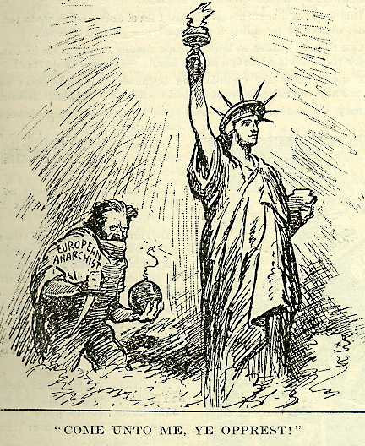
Other Industrial Centers
United States
Returns to Isolationism
First “Red scare”, from 1917 to 1920
Japan
Strong economy

Slide 6
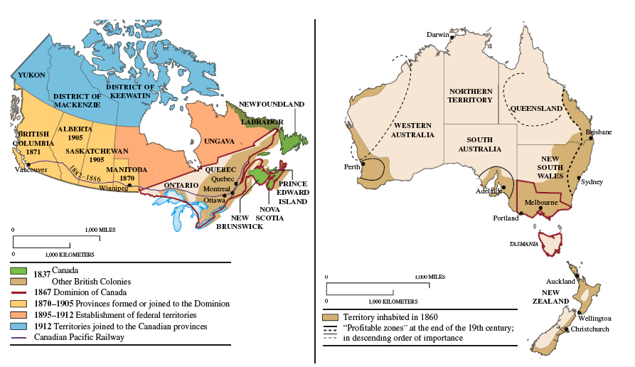
Formation of Canada, Australia, and New Zealand

Slide 7
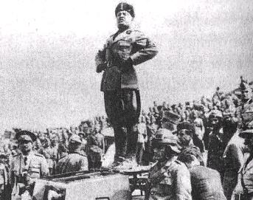
New Authoritarianism: The Rise of Fascism
In 1919, Benito Mussolini formed the Fascist Party (ITALY)
A corporate state to replace both capitalism and socialism
An aggressive foreign policy under a strong leader
Mussolini takes over government in 1922
Eliminated his opponents
Stream of nationalist propaganda
Government directed economic programs
Suspends elections in 1926

Slide 8
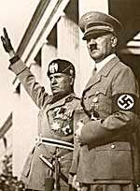
New Authoritarianism: The Rise of Fascism
New Nations of Eastern Central Europe
Authoritarian governments dominate
Same problems that plagued Western Europe
New nations created at Versailles:
Czechoslovakia had Germans, Poles, Ruthenians and Ukrainians, Slovaks and Hungarians
Poland split Germany
Others: Finland, Estonia, Latvia, Lithuania, Yugoslavia, & Turkey
Austria-Hungary were split into two separate countries
Peasant land hunger, poverty, and illiteracy continued despite regime changes.

Slide 9
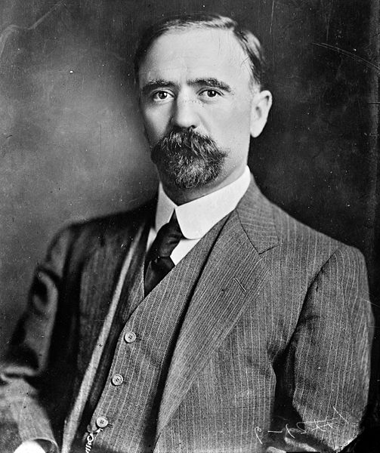
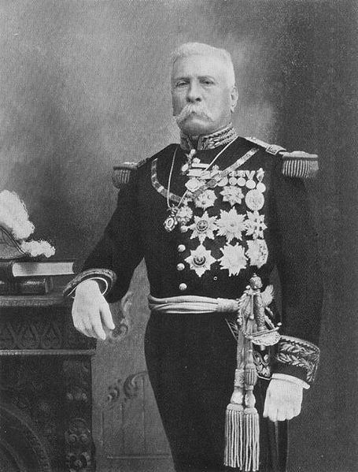
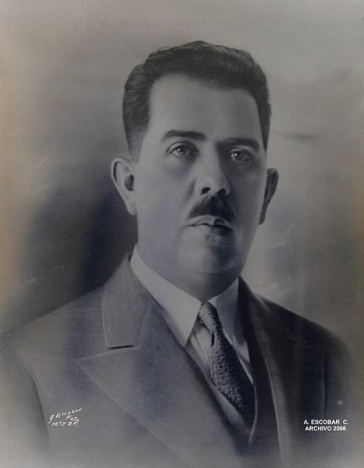
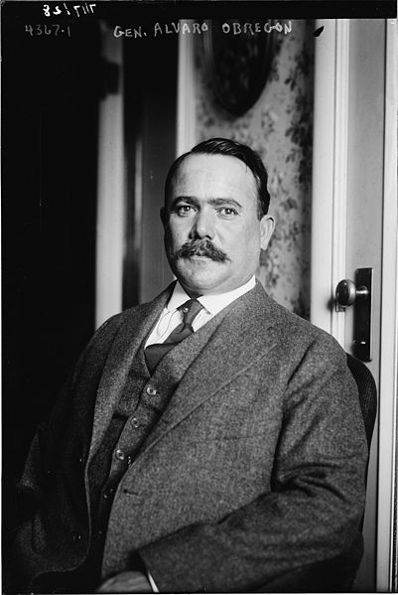
Mexico's Upheaval
Political and land reform, education, & nationalism
Porfirio Díaz, Ruler since 1876
repression and corruption
Economy under Foreign control
Francisco Madero (Gonzalez)
1910, arrested by Diaz during Presidential Election
Supposedly, Díaz wins election
Revolt against Díaz, and the Mexican Revolution began
Díaz removed 1911, Madero assassinated by, 1913:
Victoriano Huerta
Returns to Díaz’s style of rule
Forced from power, 1914

Slide 10
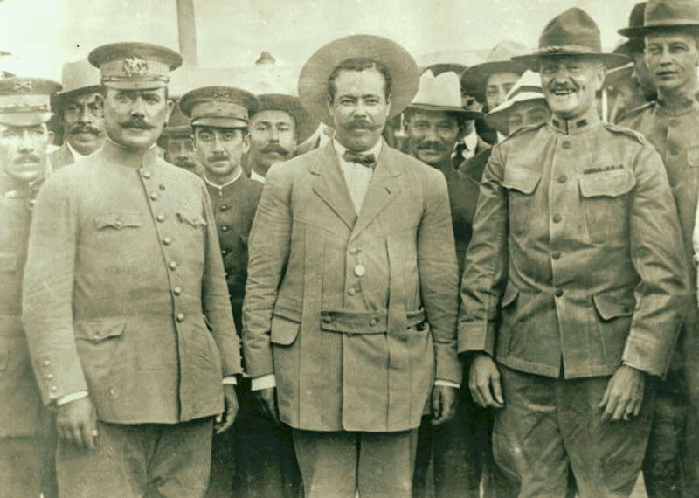
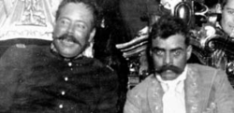
Mexico's Upheaval
Emiliano Zapata & Pancho Villa Mexican revolutionaries forced Huerta out
Zapata: who led guerrilla fighting in the South; “Tierra y Libertad”
Villa : led fighting in North into USA; pursued unsuccessfully by the Army
Soldaderas: Women who were guerrilla fighters in the Mexican Revolution
General Alvaro Obregón first elected president 1920
The constitution of 1917
Promises of land reforms (slow to materialize)
Public education (more successfully met).
President Lázaro Cárdenas (1934-1940)
Land redistributed. Mostly to communal holdings
Education expanded

Slide 11
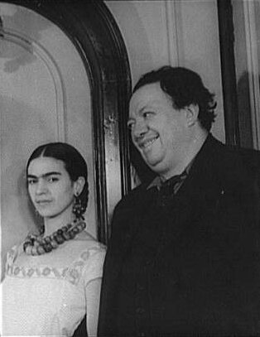
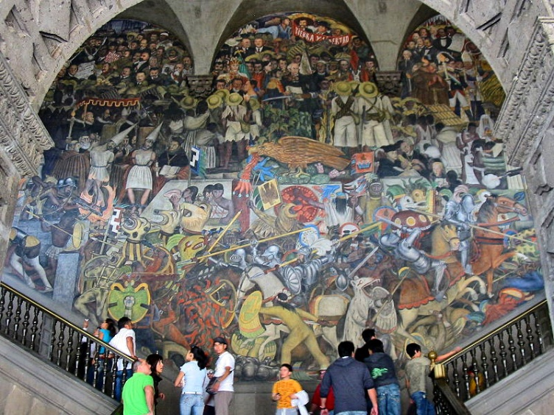
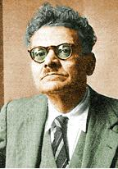
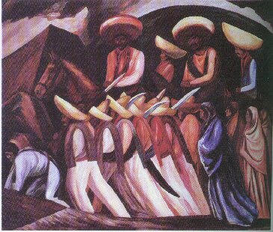
Culture and Politics in Post-revolutionary Mexico
Indian culture influence started by Gov’t
Diego Rivera, Communist muralist
Frida Kahlo, Artist wife of Rivera
José Clemente Orozco , Socialist realist painter
Cristeros
Catholic/Conservative peasant rebellion to stop secularism
Government took control of the petroleum industry.
Institutional Revolutionary Party (PRI)
In reality a one party system
developed in 1920s
controlling force in politics
until late 20th century

Slide 12
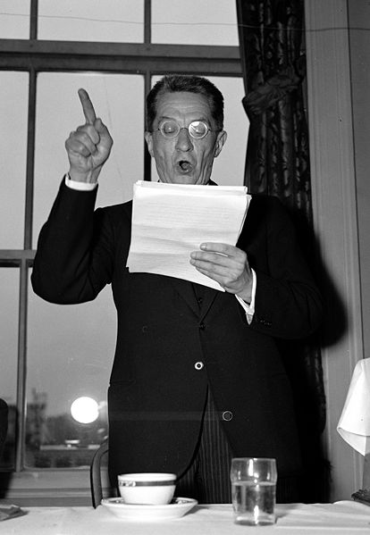
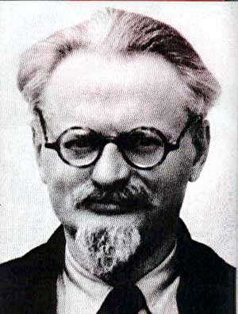
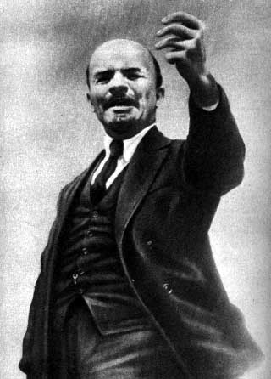
Revolution in Russia
1st (March) Revolution breaks out, 1917
Alexander Kerensky (White Bolsheviks)
Liberal provisional government
When reforms seemed slow in coming
2nd Revolution November, 1917
Bolsheviks (Communist Party)
Vladimir Lenin
Closes parliament
Congress of Soviets
Treaty of Brest-Litovsk (Ending WWI)
1918-1921
Reaction against communism (Reds)
An ensuing civil war killed millions
Red Army prevailed
Leadership of Leon Trotsky

Slide 13
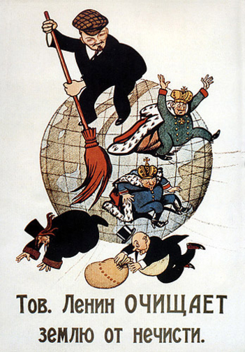
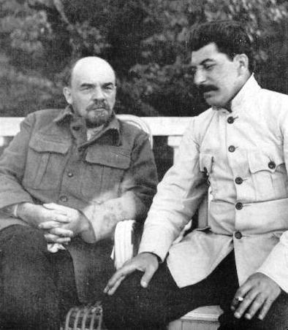
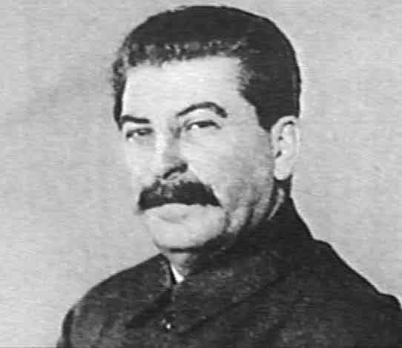
Stabilization of Russia's Communist Regime
Lenin's New Economic Policy, 1921
Stopgap economic mix of true Communism and capitalism
Food production gave Bolsheviks time to strengthen their grip on national politics
Union of Soviet Socialist Republics, 1923
“peoples’ government” in name only
Really an authoritarian system

Slide 14
Stabilization of Russia's Communist Regime
Soviet Experimentation
Gains for workers, women
This was short-lived however
Lenin dies in 1924
Power struggle broke out among Lenin’s deputies after his unexpected death
Succeeded by Stalin
Strong nationalistic version of Communism
Rivals to his political philosophy were exiled and/or killed

Slide 15
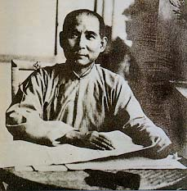
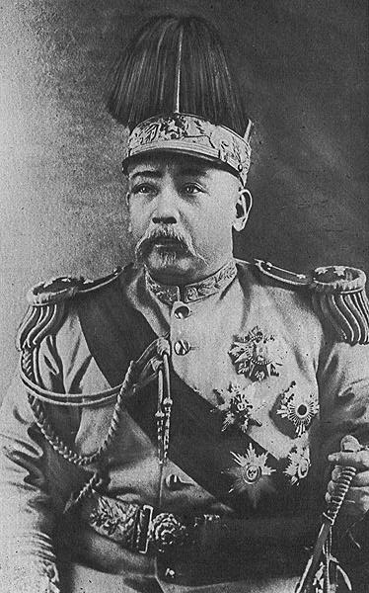
Toward Revolution in China
Last Qing emperor abdicates, 1912
1912-1928- War lord period that involved Western-educated politicians, academics, warlords, peasants, and foreign powers, most notably Japan.
Yuan Shikai 1912-1916
Takes over from Sun Yet-sen
Heads coalition
Japan (1915, WWI)
Twenty-one demands to Yuan
Yuan refuses
Control confirmed by Versailles

Slide 16
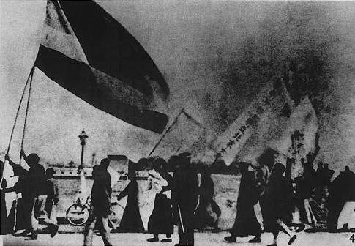
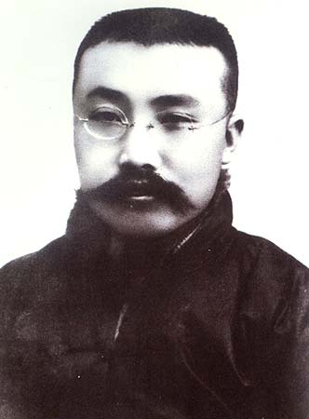
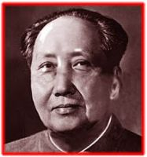
China's May Fourth Movement and the Rise of the Marxist Alternative
Yuan becomes president (Emperor)
May 4 Movement
Mass demonstrations
Call for Western political reform
Li Dazhou
Marxism adopted to Chinese situation
Influences Mao Zedong
Communist Party of China, 1921
Japan invades Manchuria 1931
began a long struggle over control

Slide 17
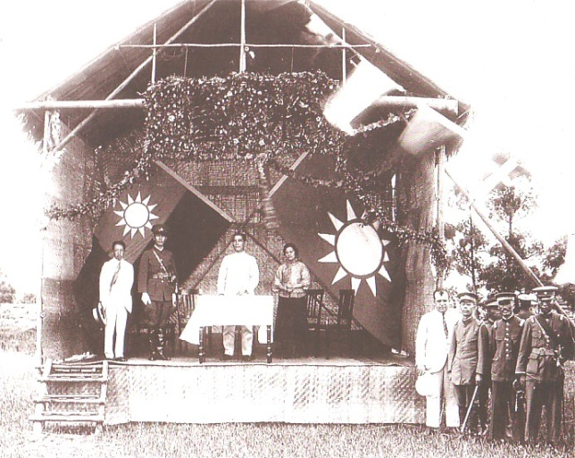
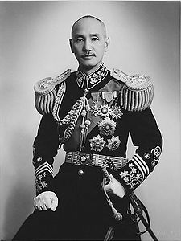
Seizure of Power by Guomindang
Guomindang (Nationalist Party of China) Sun Yat-sen
Allies with Communists
Supported by Soviet Union
Whampoa Military Academy, 1924
Chiang Kai-shek, first leader
Mao and the Peasant Option
Chiang Kai-shek succeeds as head of Guomindang, 1925
Begins civil war in 1927 (to 1949)
Shanghai massacre of 1927
Mao Zedong “Long March” to Shanxi, 1934
Maoism viewed all China “proletarian”

Slide 18
China in the Era of Revolution and Civil War
Long March

Slide 19
China in the Era of Revolution and Civil War

Slide 20
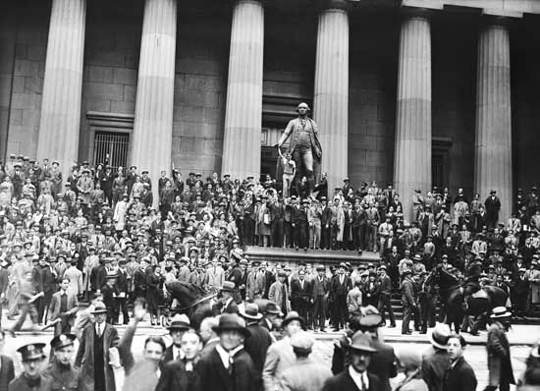
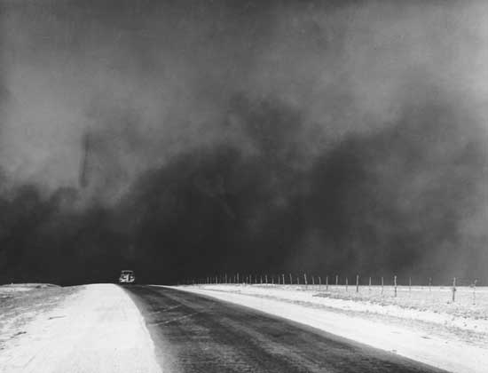
The Global Great Depression
Causation
Recession, 1920-1921
The Debacle
“Black Tuesday” 29 October 1929
New York Stock Market crash
Depression deepens, 1929-1933
Soviet Union Immune
West
Welfare programs

Slide 21
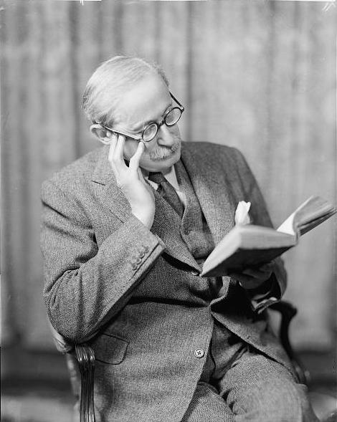
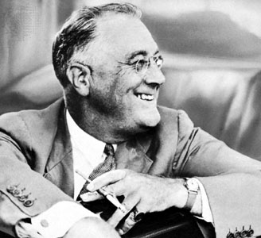
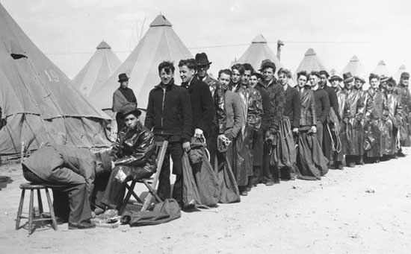
The Global Great Depression
Responses to the Depression in Western Europe
Governments have little impact
Radicalism attractive
Popular Front, 1936, Liberals, Socialists, & Communists
Ex. Léon Blum's French Popular Front
The New Deal
Franklin Roosevelt

Slide 22
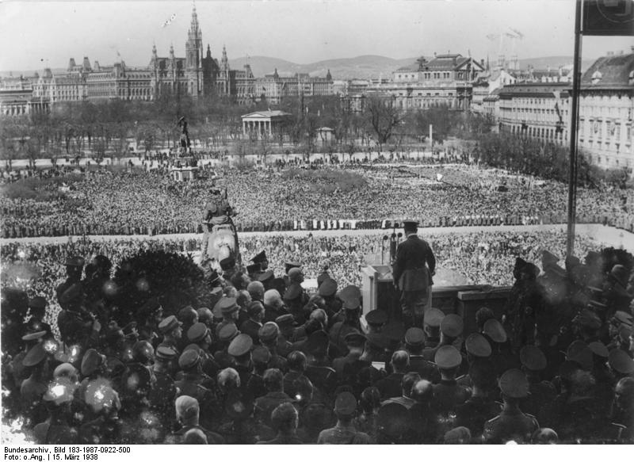
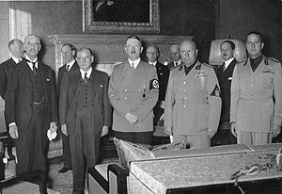
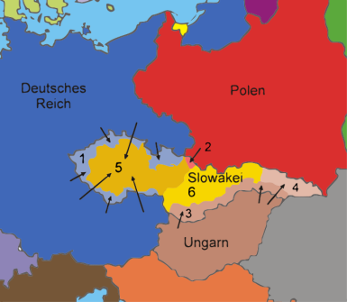
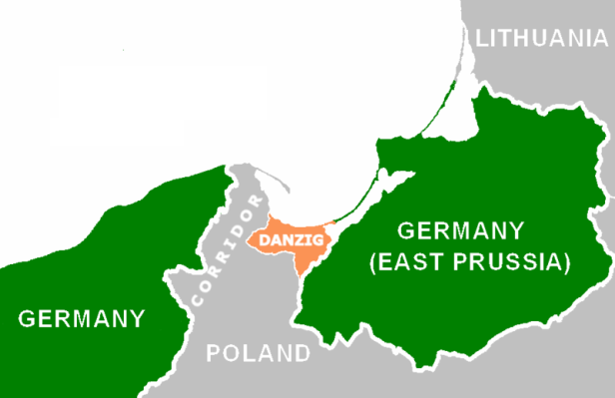
The Rise of Nazism
Fascism, 1920s
Adolf Hitler
National Socialist party
1932 elections
Anti-Semitic
1933, takes power
Totalitarian
Appeasement:
Rhineland, Occupied, 1936, No response
Anschlutz, 1938
Political/Military takeover of Austria, No response
Sudetenland, 1938-1939
Political/Military takeover of the German speaking
area of Czechoslovakia, resulted in Munich Conference, more yielding to Adolf Hitler, transferred it to Germany
Invasion of Poland, 1939 -WWII Starts

Slide 23
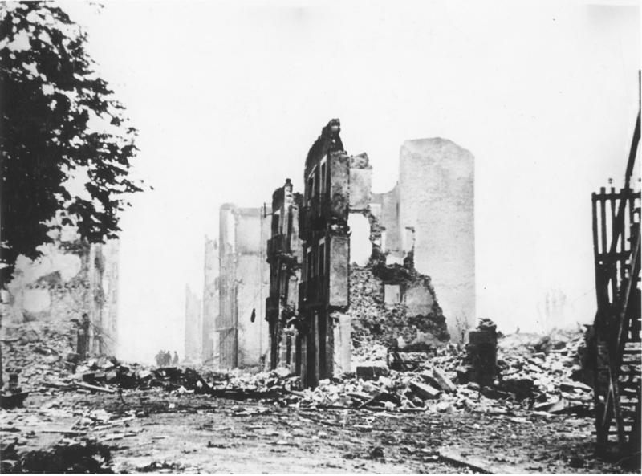
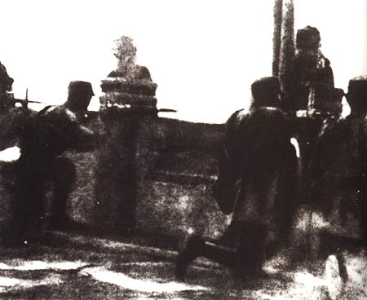
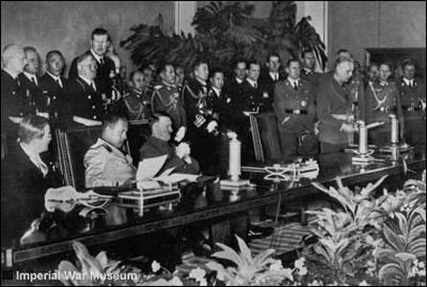
The Spread of Fascism
Ruins of Guernica
Mussolini
Invades Ethiopia, 1935
Rome-Berlin axis, 1936
Spanish Civil War, 1936-1939
Germany, Italy support Franco
Russia, Western volunteers support, New liberal Gov’t
Japan invades China, 1937
Rape of Nanking (Dec 1937)
Tripartite Pact, Axis, (Sept 1940)
Germany, Italy, & Japan
Marco Polo Bridge

Slide 24
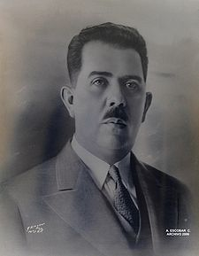
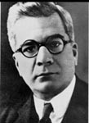
Economic and Political Changes in Latin America
The Great Crash and Latin American Responses
Conservatives
Remain the same? Corruption?
Corporatism
the theory and practice of organizing society into “corporations” subordinate to the state
Fascism
extreme militaristic nationalism, contempt for electoral democracy and political and cultural liberalism, a belief in natural social hierarchy and the rule of elites, and the desire to create a “people's community”, in which individual interests would be subordinated to the good of the nation
Mexico
Lázaro Cárdenas (1934-1940)
PRI Party (Socialist)
Many Reforms
Cuba
2 Revolutions, in 1933 (3 Presidents)
Cuban Dictator Machado

Slide 25
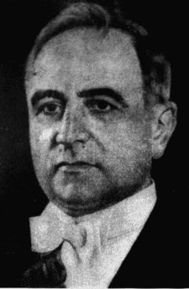
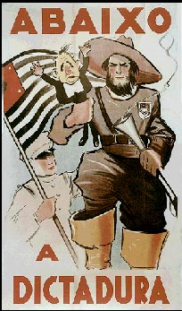
Economic and Political Changes in Latin America
Brazil was a rapidly industrializing nation "the sleeping giant of the Americas“
1929 Election
Civil war
President (Dictator) Getulio Vargas established a corporatist regime in Brazil
"The father of the poor"
1930-1954
Modeled on Mussolini’s Italy
However, backed the Allies in World War II.
Much of Brazilian history since his death has been a struggle over his legacy.
New constitution, 1937
Influenced by Mussolini Suicide, 1954

Slide 26
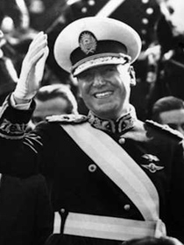
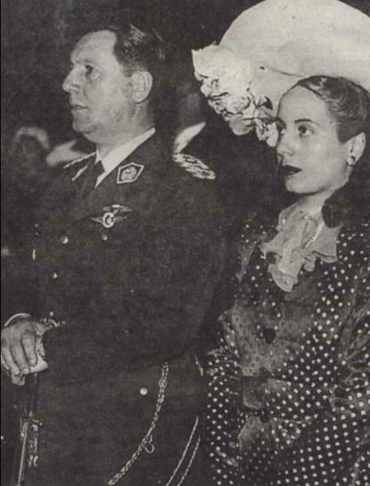
Argentina: Populism, Perón, and the Military
Economic collapse, 1929
Nationalists Take control, 1943
Juan d. Perón (1946-1955)
Wife, Eva Duarte (d. 1952)
Coalition government
Driven from power, 1955
Maintains influence
Exiled to Spain 18 years
Returns to Office 1973–1974
Death of Perón, 1974
Return of military rule

Slide 27
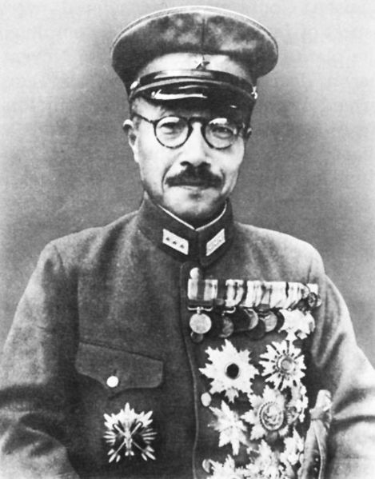
The Militarization of Japan
The Militarization of Japan
Nationalists Revolts, 1930s
1930: Prime Minister Hamaguchi assassinated
1931: March Incident and Imperial Colors Incident (abortive coup)
1932: May 15 Incident; Prime Minister Inukai assassinated
1933: proto-fascist Kokumin Domei formed
1936: February 26 Incident: Prime Minister Okada Keisuke escapes assassination
Military (Army) gains power
Tojo Hideki (also, Prime Minister 41-44)
Influence over prime ministers
1936 Tōhōkai (Fascist political party)
War with China, 1937
Military ascendant
By 1938
Control of Korea, Manchuria, Taiwan

Slide 28
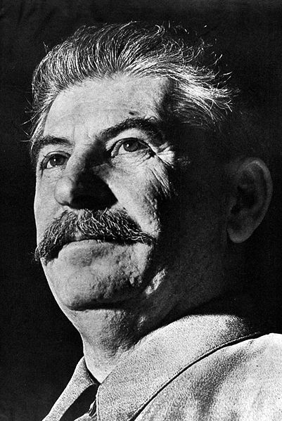
Stalinism
From 1927
Industrialization
Politburo- Communist Party in USSR
Economic Policies
Collectivization, 1928
Joint enterprise farming
Mechanization
Kulaks resist (Middle Class Farmers)
Suppression (Dekulakization)
Five-year plans
Factories (#1 Industry by WWII)
Toward an Industrial Society
Totalitarian Rule
Harsh suppression of criticism
Treaty of Non-Aggression (24 August 1939)
Allies with Hitler before WWII (Sept 1)

Slide 29
Stalinism
Five-year plans
Factories (#1 Industry by WWII)
Toward an Industrial Society
Totalitarian Rule
Harsh suppression of criticism
Treaty of Non-Aggression (24 August 1939)
Allies with Hitler before WWII (Sept 1)

